Slide 1
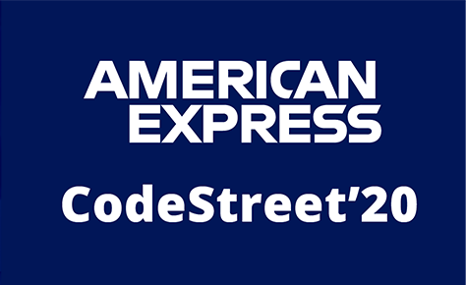

Realtime Payments
Credit-Card Fraud Detection System
A One stop Real Time Payments Solution For all businesses
Problem Statement (Idea) :
Developing a Robust and at power Credit-card Fraud Detection System by combining industry leading ML Algorithms with advanced blockchain based verification methods. Along with a multilayered fraud detection system which helps the business to meet consumer demands for speed and convenience.
Team Name : Power Puff Boys
Team Members :
Mohan Arora
Sidhant Goyal
Harshil Sharma
Prateek Bansal

Slide 2
Agenda
Maintaining Speed, Accuracy and Convenience:
Detecting fraudulent transactions should take place at real time and not in future after the payment has been made, but it should not interfere with customers ease of use
Handling Highly Skewed Data:
The major problem in real world data is that the data is highly skewed in nature and thus difficult to work with.
Save Business:
Financial institutions loose a lot of funds every year in order to payback and track fraudulent transactions
Eliminating Redundant verifications:
Some steps of credit card fraud detection scheme are redundant and can be simplified with minor tweaks in the databases

Slide 3

Types of Frauds Handled
Realtime payments make it very attractive for fraudsters to attack accounts. With increased customer convenience, there seems to be a cost of security, particular types of bank accounts that offer customers the ability to send money instantly, especially if they allow for relatively large value payments, are likely to be a target for fraudsters.
1.Card-not-present (CNP) fraud
2. Skimming fraud
3. Lost Card Fraud
4. Card never arrived Fraud
5. Identity Fraud
6. Account Takeover fraud
7. Social Engineering Techniques
8. Phishing fraud

Slide 4
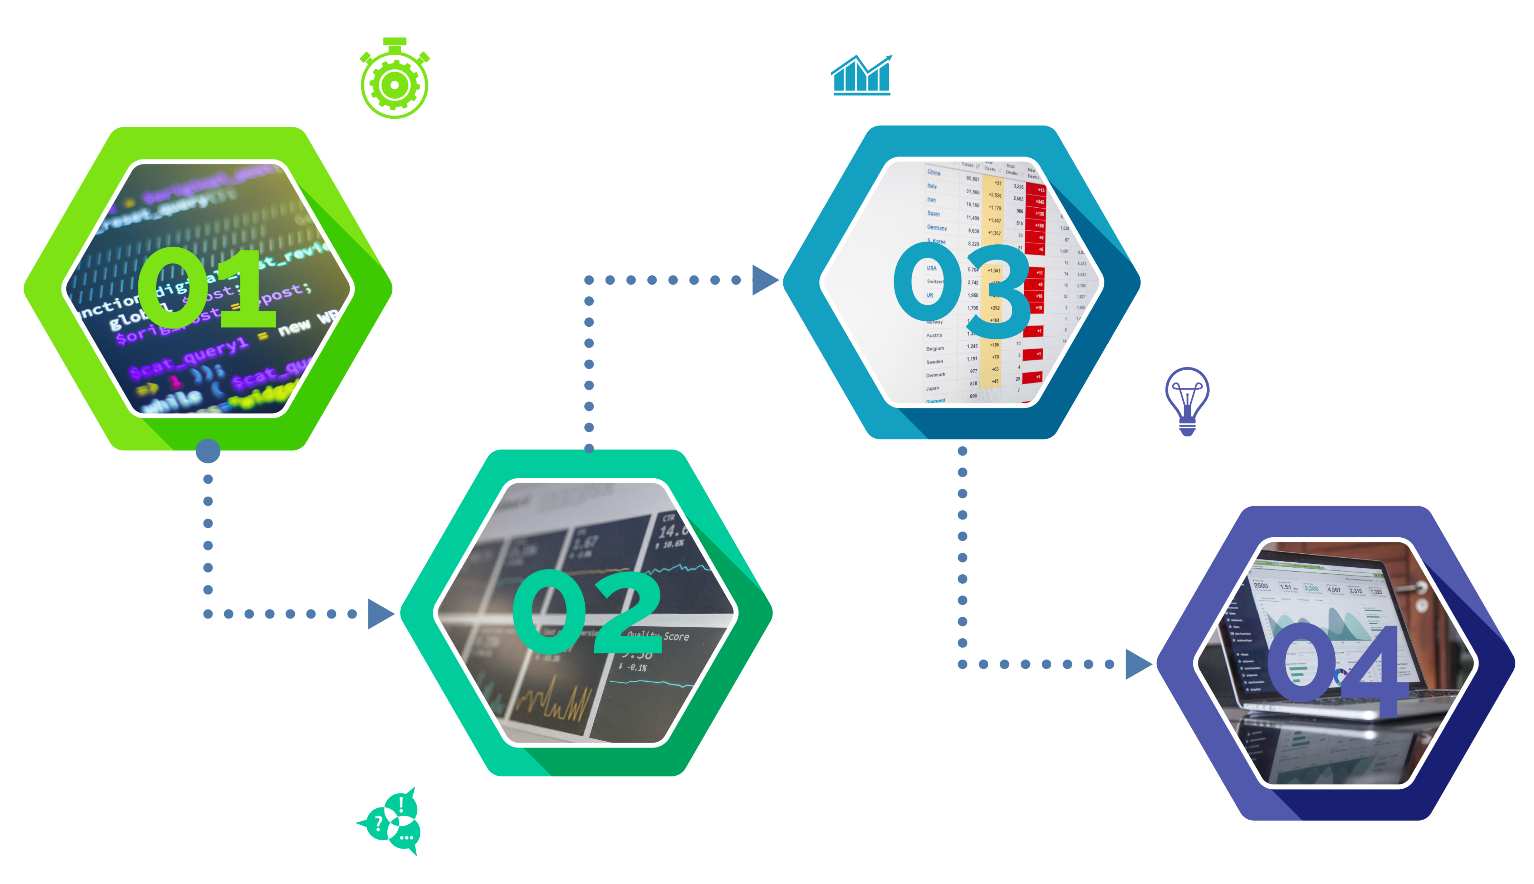
Flowchart
Step3: Prediction
Creating a robust and self-learning ML system which learns from past predictions and makes changes through a layered structure
Step1: Pre-processing
Includes a combination of two novel technique called SMOTE Over-sampling + Under-sampling, along with labelling data
Step4: Depiction
Showcasing the data to the end user in a constructive way to bring on a comprehensive result
Step2: ML Analysis
Using a combination of different industry leading ML models combined into an Ensemble Model

Slide 5
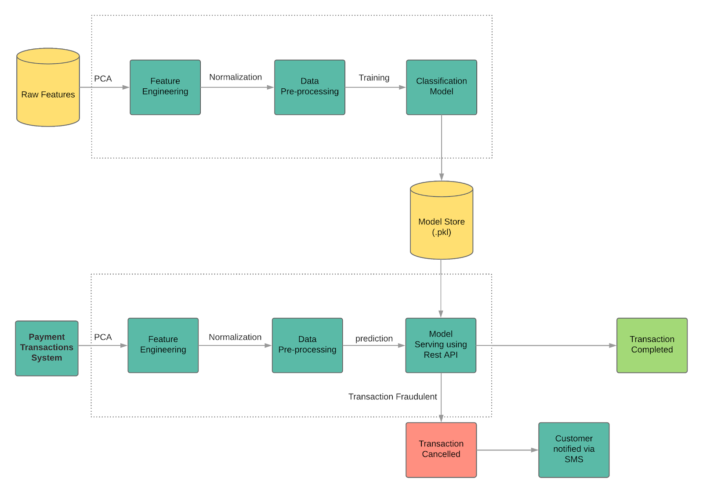
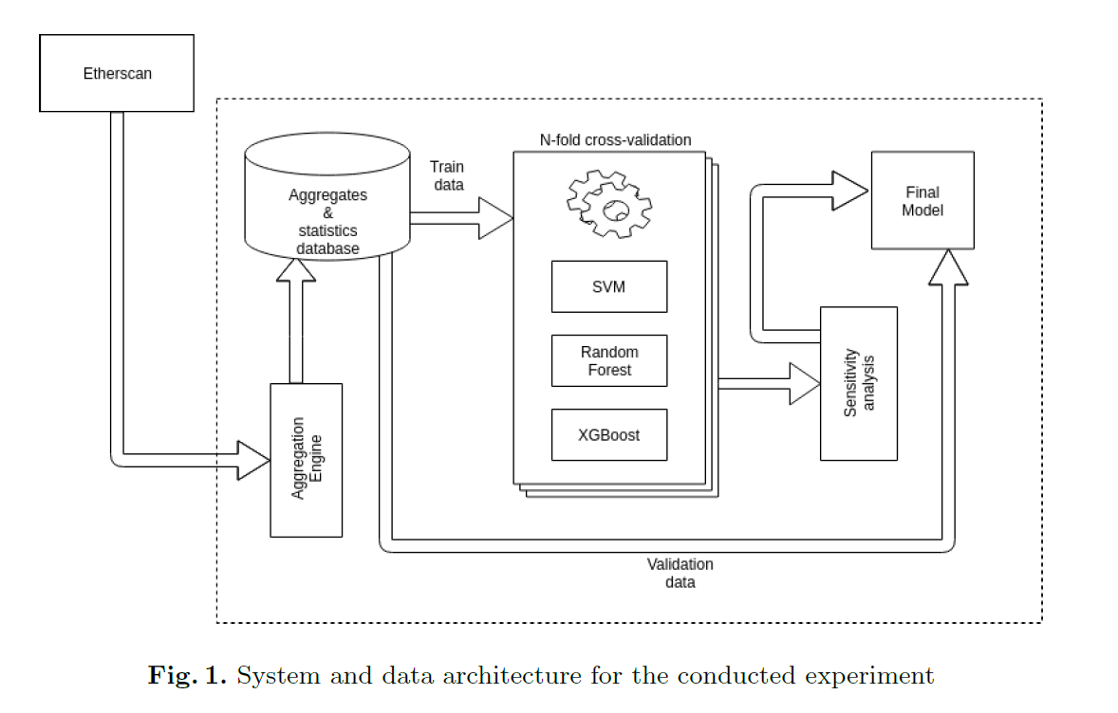
Our Approach
Pre-processing
SMOTE Over-sampling + Under-sampling
PCA
ML Models Used:
K-means
AutoEncoder
Xg-Boost
RandomForest Classifier
ANN
Transaction Data from App
Fig1: Proposed Architecture
Fig2: Process Visualisation

Slide 6
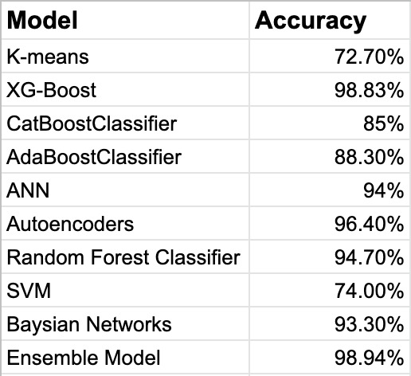
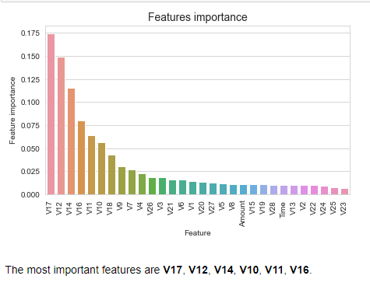
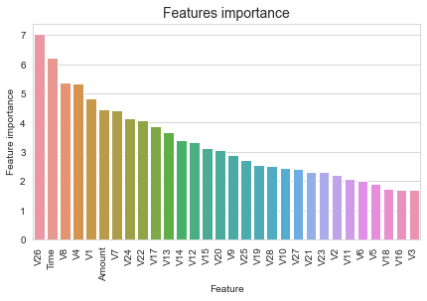
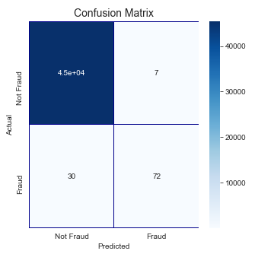
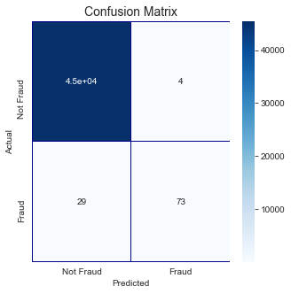
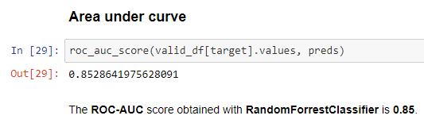
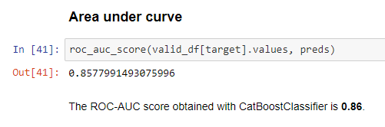
Results

Slide 7
Parameters
Dataset Used | No. of rows | Source | Models Used | Avg. Time Taken | Accuracy | F1 Score
Credit Card Fraud Detection-ULD | 284,807 | Worldline and the Machine Learning Group | XG-boost K-means RandomForest classifires | 1 hr | 95% | .82
Synthetic Financial Datasets For Fraud Detection | 6,32,892 | PaySim | XG-boost K-means RandomForest classifires ANN | 3 Hr | 92% | .72
IEEE-CIS Fraud Detection | 590663 | IEEE-CIS | XG-boost K-means RandomForest classifires ANN | 3 hr | 93% | .83

Slide 8
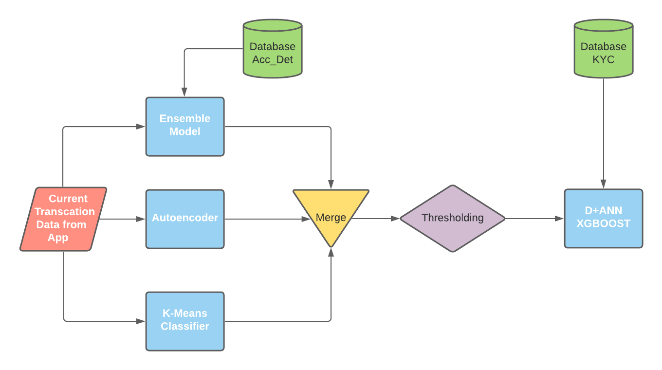
Project Architecture:
Using 4 different models to increase User experience by minimizing the delay
Unique thresholding technique in which if weighted probabilities from the 3 preliminary models is less than .72 then only the 4 model is used
Fig1: Project Architecture

Slide 9
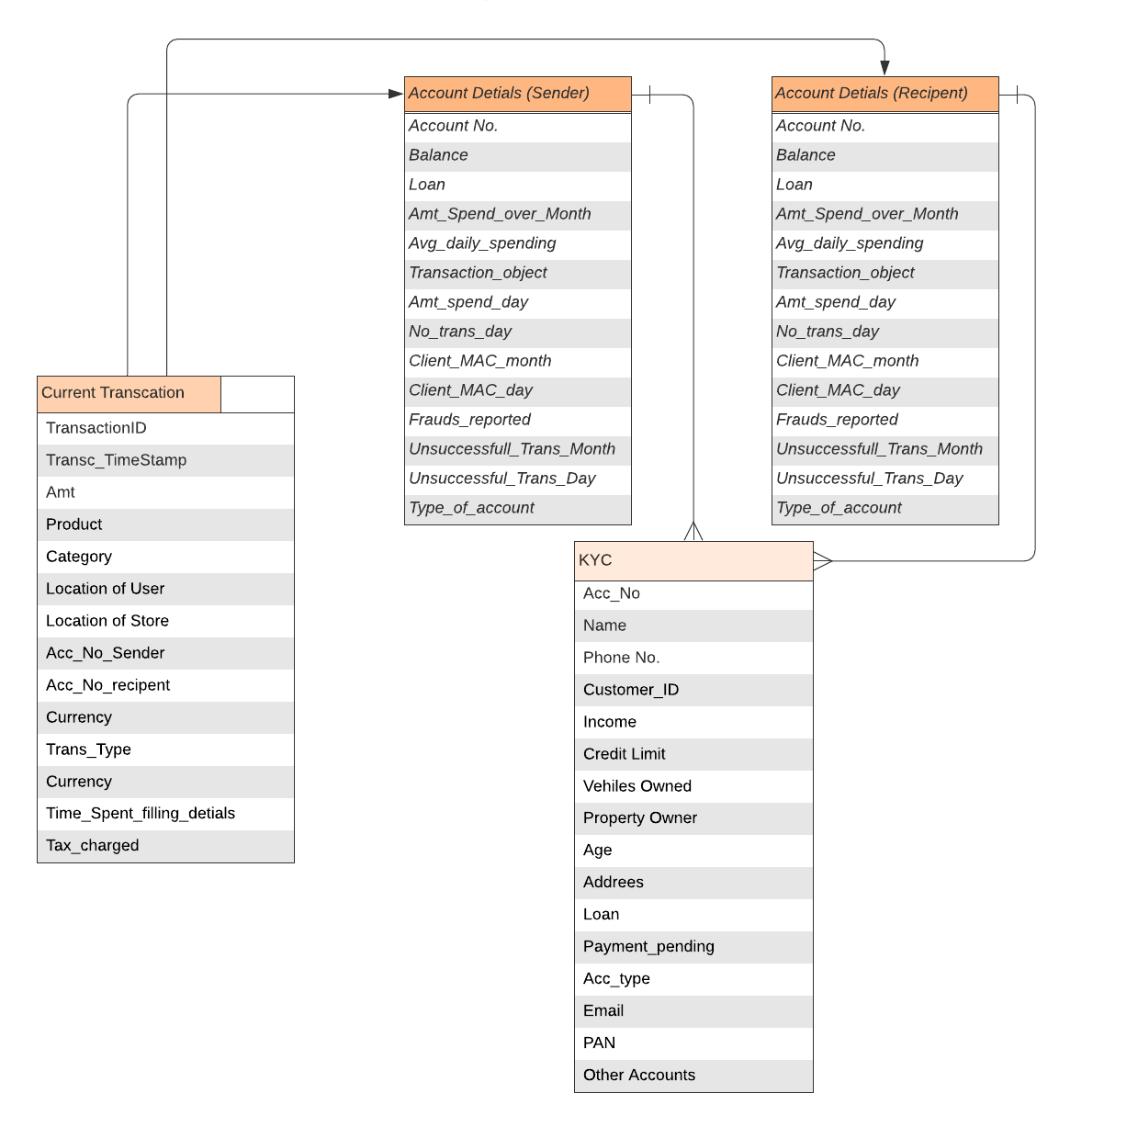
Database Schema(SQL DB)
SQL base Database to increase system efficiency
Divided into 3 tables i.e.
Customer
Account
Transaction
Separately linked KYC details table
Fig1: SQL DB Table Structure

Slide 10

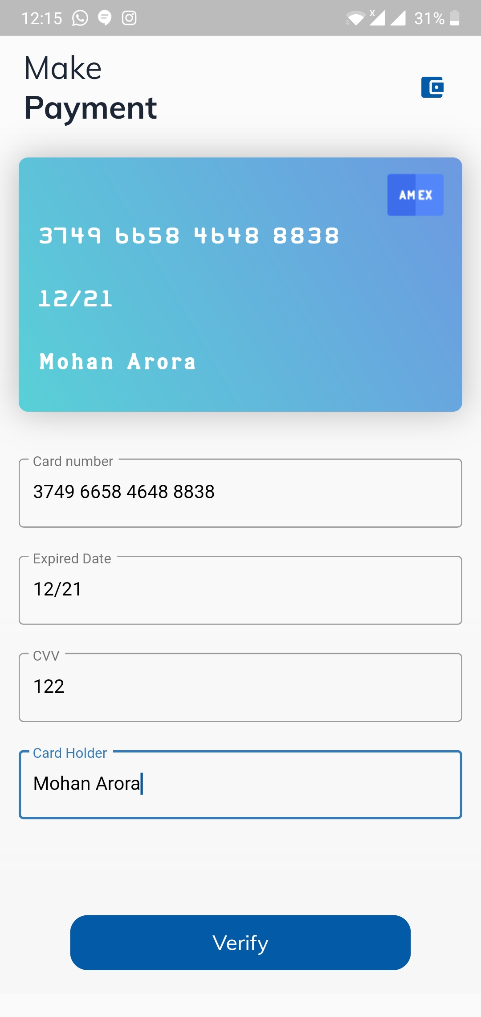
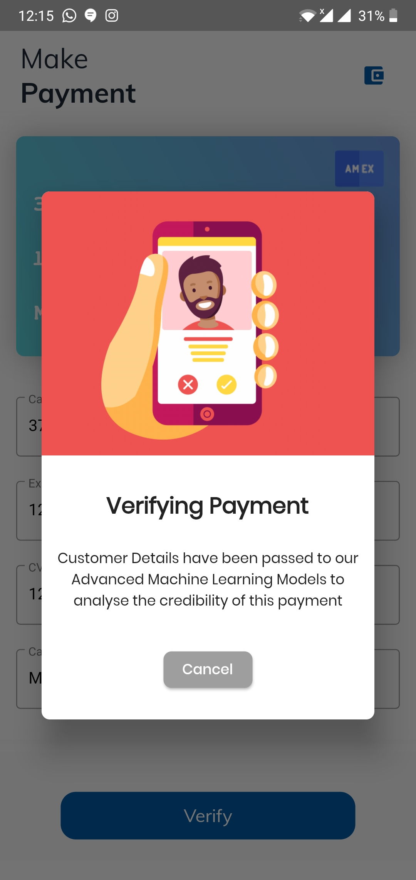

Frontend App
Notes:
Our objective was to find a prediction model that could be used as a real-world fraud detection system. Due to the high class imbalance we decided to focus our assessment of a particular algorithm on analyzing recall and precision statistics.
For different parameters congurations we obtained results with either high recall
and low precision or low recall and high precision. The former one has an obvious
advantage of capturing most of the frauds that were present in a dataset. On
the other hand, it is completely useless for a real world applications in which all
the alerts have to be manually analyzed by a human being.
As we included almost all of the fraudulent transaction and only minor sample
of non-fraudulent, we had distribution in which probability of a random account
being a fraudulent one was signicantly higher than in the real-world. Because of
that, we could not rely on precision statistic as it is vulnerable to this problem.
Instead of using precision as a false alarm verication cost estimator we decided
to use false positive rate. It ts our purpose since it does not depend on the total
amount of frauds in the dataset.

Slide 11
User Integration
API
Can Be used by any Application with proper authentication tokens
Use our database to detect fraudulent transaction
Plug and Play
SDK
Can be integrated in and IOS or Android App
Will used combined database of our’s and the companies it self
Easy to integrate as made via flutter
Notes:
Our objective was to find a prediction model that could be used as a real-world fraud detection system. Due to the high class imbalance we decided to focus our assessment of a particular algorithm on analyzing recall and precision statistics.
For different parameters congurations we obtained results with either high recall
and low precision or low recall and high precision. The former one has an obvious
advantage of capturing most of the frauds that were present in a dataset. On
the other hand, it is completely useless for a real world applications in which all
the alerts have to be manually analyzed by a human being.
As we included almost all of the fraudulent transaction and only minor sample
of non-fraudulent, we had distribution in which probability of a random account
being a fraudulent one was signicantly higher than in the real-world. Because of
that, we could not rely on precision statistic as it is vulnerable to this problem.
Instead of using precision as a false alarm verication cost estimator we decided
to use false positive rate. It ts our purpose since it does not depend on the total
amount of frauds in the dataset.

Slide 12



Improved Accuracy
Business Impact
Sensitivity & Specificity
Ease of use
Customers will face less down time and waits on their credit card spending because of the faster resolution of fraud cases
Resolution of fraud cases from the genuine mistakes with greater accuracy would be a novel feature in our proposed system
With our ready made plug and play APIs, this fraud detection system can be integrated with real time payment methods instantly

Slide 13



Behavior and Location Analysis (BLA)
Novelty
Tokenization
Smart Contracts
Based on the geographical location where the credit card user lives he is put in one of the buckets to better understand the spending patterns of a locality and fill in the gaps
Replacing the 16 digit card number with a ‘Token’. Credit card tokenization helps e-commerce websites improve security, as it eliminates the need for storing credit card data, and reduces security breaches.
storing KYC verification data in distributed networks in a blockchain, along with the ability to execute smart contracts
Notes:
Behavior and Location Analysis (BLA) is based upon the geographical areas that the customers live in so as to understand the spending pattern of that locality more closely and clustering their behavior. When a new card is issued, there is no previous data about that customer. So an average case can be taken for that user in his initial transactions, depending on what category he belongs to. if any unusual pattern is detected, the system requires re-verification. System will block the user after 3 invalid attempts. User spending patterns and geographical location is used to verify the identity In this BLA technique
Behavioral patters like shopping imported items, average payment, frequency of payments in a day or over a month
Tokenization is a process by which a 16-digit card number gets replaced by a digital identifier known as a ‘token’. This Is a very well know and established technique used in stake based cryptocurrencies like etherium we have just borrowed the idea and implemented it here. Credit card tokenization helps e-commerce websites improve security, as it eliminates the need for storing credit card data, and reduces security breaches.
This helps when the ecommerce website's data is under breach.
in the case of ecommerce breach, there is a huge loss of security of the accounts.

Slide 14
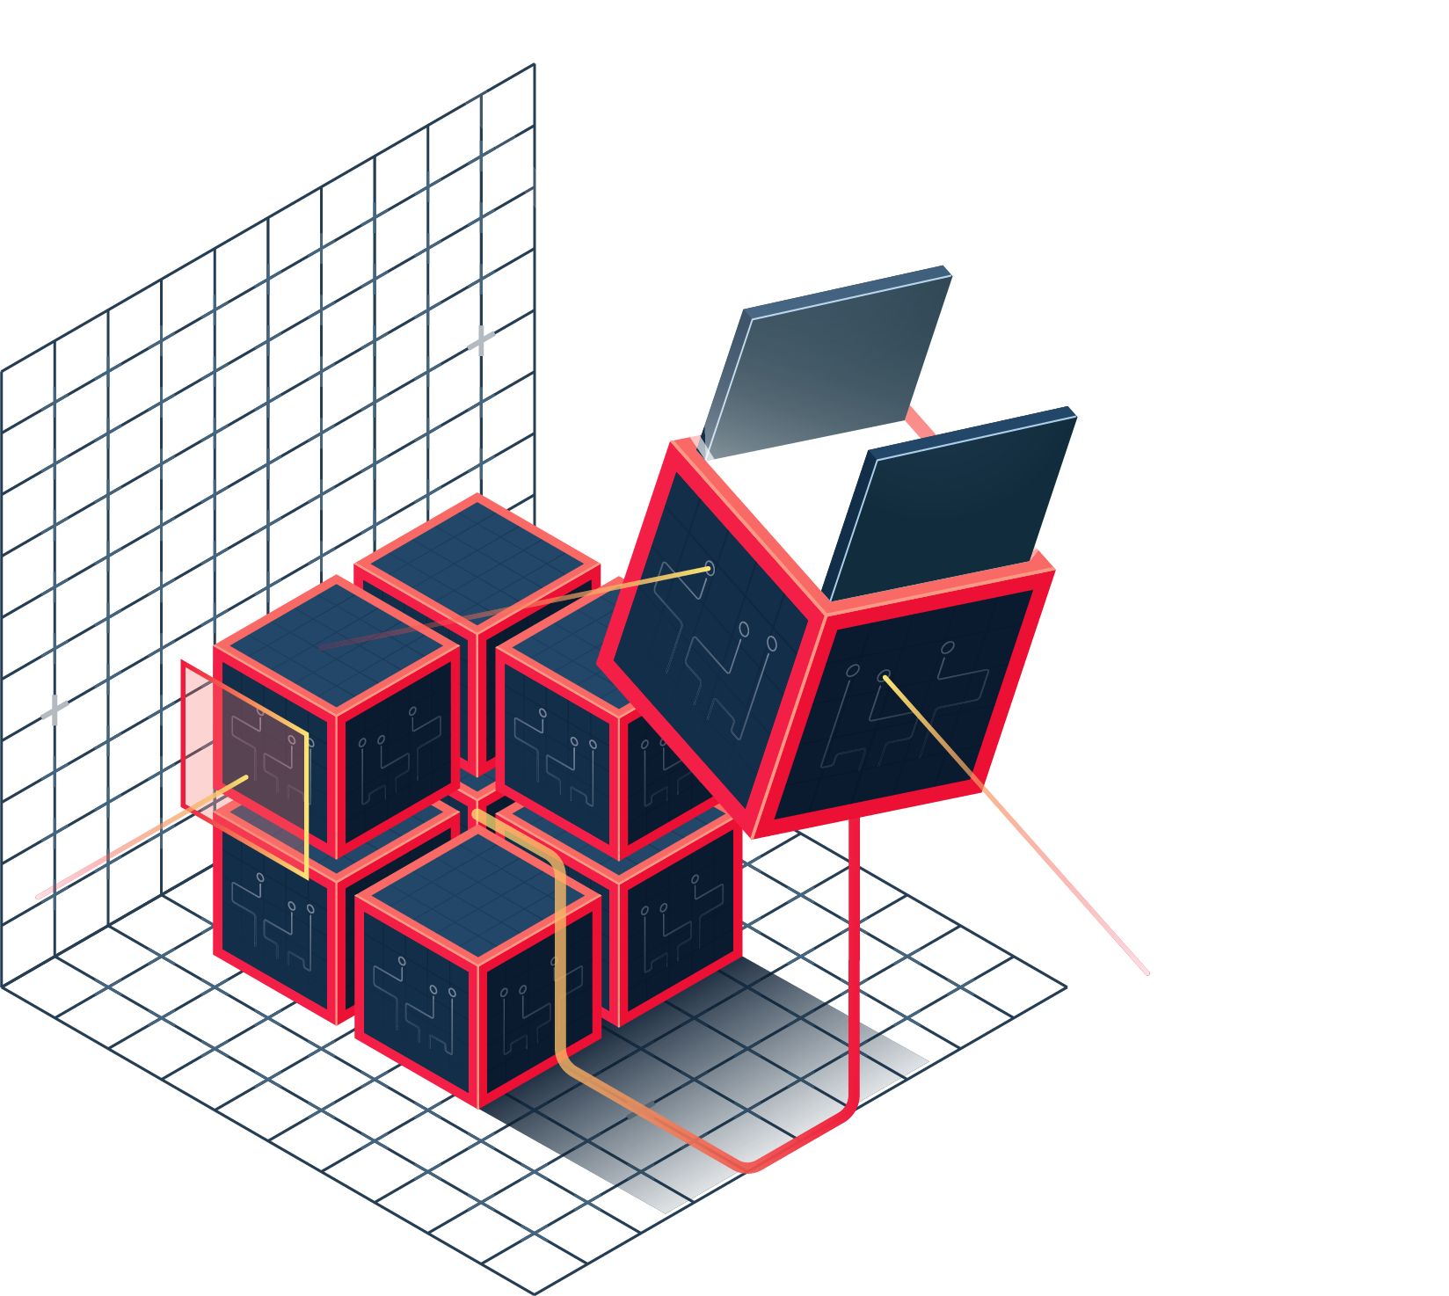


Going Forward, we plan to
Single, unified KYC verification Database for cutting down the repetitive individual checking by different institutions. Database will be maintained in a safe BlockChain Architecture which guarantees no hampering whatsoever. Also the number of fraudulent transactions will be linked to a person’s KYC block and after a set threshold is crossed, the person will be temporarily blocked from conducting transactions online
Deployment of SmartContracts which ensure that after a certain action is performed, a series of actions follow
+
+
Safety Of Blockchain
Reliability of Pen and Paper
KYC on a distributed Network
Features of KYC Blockchain Architecture

Slide 15






Financial Model
Cost1: API
0.2% of transactions
Cost4: Maintenance
Rs 20,000-Rs 30,000/month
Cost2: Deployment
One-time cost of Rs 3.2 lack
Cost5: Hosting
User Dependant(10,000)
Cost3: SDK
0.1% of transactions

Slide 16

Tech Stack

Slide 17




Our Team
Sidhant Goyal
Data Scientist
Mohan Arora
Flutter Developer
Harshil Sharma
ML Research
Prateek Bansal
ML Research

Slide 18
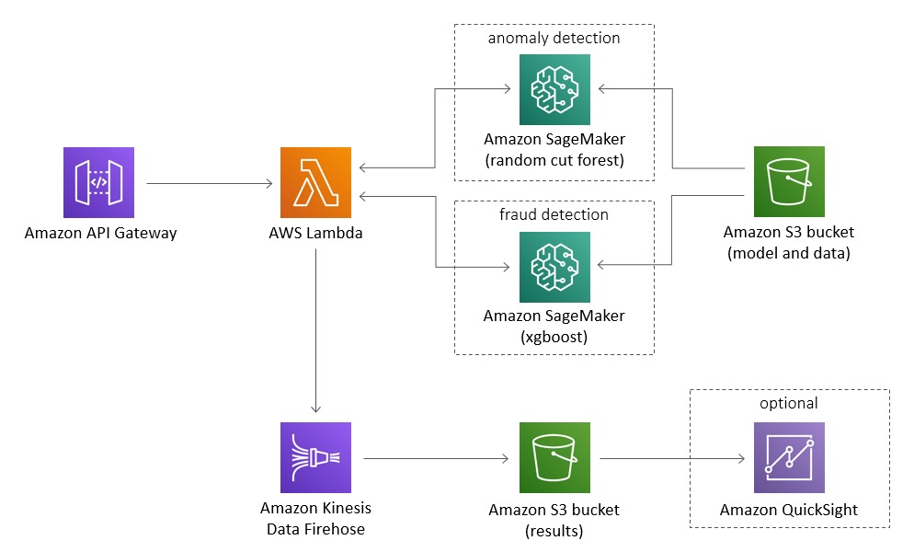
Proposed Architecture AWS Enabled Anomaly Detection
Anomaly detection is a technique used to identify unusual patterns that do not conform to expected behavior, called outliers.
Anomaly Detection Techniques Used
Notes:
Anomaly detection is a technique used to identify unusual patterns that do not conform to expected behavior, called outliers. It has many applications in business, from intrusion detection (identifying strange patterns in network traffic that could signal a hack) to system health monitoring (spotting a malignant tumor in an MRI scan), and from fraud detection in credit card transactions to fault detection in operating environments.
In data mining, anomaly detection (also outlier detection) is the identification of rare items, events or observations which raise suspicions by differing significantly from the majority of the data. Anomalies can be broadly categorized as:
Point anomalies: A single instance of data is anomalous if it's too far off from the rest. Business use case: Detecting credit card fraud based on "amount spent."
Contextual anomalies: The abnormality is context specific. This type of anomaly is common in time-series data. Business use case: Spending $100 on food every day during the holiday season is normal, but may be odd otherwise.
Collective anomalies: A set of data instances collectively helps in detecting anomalies. Business use case: Someone is trying to copy data form a remote machine to a local host unexpectedly, an anomaly that would be flagged as a potential cyber attack.
Anomaly detection is similar to — but not entirely the same as — noise removal and novelty detection.
Novelty detection is concerned with identifying an unobserved pattern in new observations not included in training data like a sudden interest in a new channel on YouTube during Christmas, for instance.
Noise removal (NR) is the process of removing noise from an otherwise meaningful signal.
Observations :
Isolation Forest detected 73 errors versus Local Outlier Factor detecting 97 errors vs. SVM detecting 8516 errors
Isolation Forest has a 99.74% more accurate than LOF of 99.65% and SVM of 70.09
When comparing error precision & recall for 3 models , the Isolation Forest performed much better than the LOF as we can see that the detection of fraud cases is around 27 % versus LOF detection rate of just 2 % and SVM of 0%.
So overall Isolation Forest Method performed much better in determining the fraud cases which is around 30%.
We can also improve on this accuracy by increasing the sample size or use deep learning algorithms however at the cost of computational expense.We can also use complex anomaly detection models to get better accuracy in determining more fraudulent cases

Slide 19
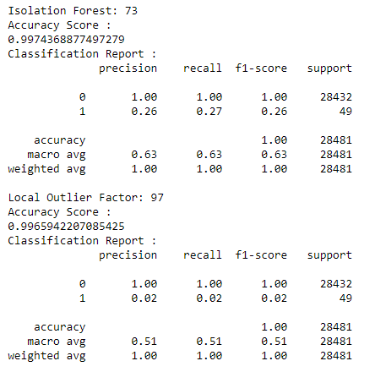
Technique1: Anomaly Detection
Anomaly detection is a technique used to identify unusual patterns that do not conform to expected behavior, called outliers.
Anomaly Detection Techniques Used
Simple Statistical Methods
Density-Based Anomaly Detection
K-nearest neighbour
Relative density of data
Clustering-Based Anomaly Detection
Support Vector Machine-Based Anomaly Detection
Isolation Forest Anomaly Detection Algorithm
Local Outlier Factor(LOF) Algorithm
Notes:
Anomaly detection is a technique used to identify unusual patterns that do not conform to expected behavior, called outliers. It has many applications in business, from intrusion detection (identifying strange patterns in network traffic that could signal a hack) to system health monitoring (spotting a malignant tumor in an MRI scan), and from fraud detection in credit card transactions to fault detection in operating environments.
In data mining, anomaly detection (also outlier detection) is the identification of rare items, events or observations which raise suspicions by differing significantly from the majority of the data. Anomalies can be broadly categorized as:
Point anomalies: A single instance of data is anomalous if it's too far off from the rest. Business use case: Detecting credit card fraud based on "amount spent."
Contextual anomalies: The abnormality is context specific. This type of anomaly is common in time-series data. Business use case: Spending $100 on food every day during the holiday season is normal, but may be odd otherwise.
Collective anomalies: A set of data instances collectively helps in detecting anomalies. Business use case: Someone is trying to copy data form a remote machine to a local host unexpectedly, an anomaly that would be flagged as a potential cyber attack.
Anomaly detection is similar to — but not entirely the same as — noise removal and novelty detection.
Novelty detection is concerned with identifying an unobserved pattern in new observations not included in training data like a sudden interest in a new channel on YouTube during Christmas, for instance.
Noise removal (NR) is the process of removing noise from an otherwise meaningful signal.
Observations :
Isolation Forest detected 73 errors versus Local Outlier Factor detecting 97 errors vs. SVM detecting 8516 errors
Isolation Forest has a 99.74% more accurate than LOF of 99.65% and SVM of 70.09
When comparing error precision & recall for 3 models , the Isolation Forest performed much better than the LOF as we can see that the detection of fraud cases is around 27 % versus LOF detection rate of just 2 % and SVM of 0%.
So overall Isolation Forest Method performed much better in determining the fraud cases which is around 30%.
We can also improve on this accuracy by increasing the sample size or use deep learning algorithms however at the cost of computational expense.We can also use complex anomaly detection models to get better accuracy in determining more fraudulent cases

Slide 20
Technique2: Auto Encoders
An autoencoder is a type of artificial neural network used to learn efficient data codings in an unsupervised manner.
The aim of an autoencoder is to learn a representation (encoding) for a set of data, typically for the purpose of dimensionality reduction.
Dimensionality Reduction:
An autoencoder learns to compress data from the input layer into a short code, and then uncompress that code into something that closely matches the original data. This forces the autoencoder to engage in dimensionality reduction
Multilayer Perceptron(MLP):
The simplest form of an autoencoder is a feedforward, non-recurrent neural network very similar to the many single layer perceptrons which makes a multilayer perceptron (MLP) – having an input layer, an output layer and one or more hidden layers connecting them – but with the output layer having the same number of nodes as the input layer, and with the purpose of reconstructing its own inputs (instead of predicting the target value Y given inputs X). Therefore, autoencoders are unsupervised learning models.
Notes:
Autoencoders
An autoencoder is a type of artificial neural network used to learn efficient data codings in an unsupervised manner.
The aim of an autoencoder is to learn a representation (encoding) for a set of data, typically for the purpose of dimensionality reduction.
An autoencoder learns to compress data from the input layer into a short code, and then uncompress that code into something that closely matches the original data. This forces the autoencoder to engage in dimensionality reduction, for example by learning how to ignore noise. Some architectures use stacked sparse autoencoder layers for image recognition. The first autoencoder might learn to encode easy features like corners, the second to analyze the first layer's output and then encode less local features like the tip of a nose, the third might encode a whole nose, etc., until the final autoencoder encodes the whole image into a code that matches (for example) the concept of "cat".An alternative use is as a generative model: for example, if a system is manually fed the codes it has learned for "cat" and "flying", it may attempt to generate an image of a flying cat, even if it has never seen a flying cat before.
The simplest form of an autoencoder is a feedforward, non-recurrent neural network very similar to the many single layer perceptrons which makes a multilayer perceptron (MLP) – having an input layer, an output layer and one or more hidden layers connecting them – but with the output layer having the same number of nodes as the input layer, and with the purpose of reconstructing its own inputs (instead of predicting the target value Y given inputs X). Therefore, autoencoders are unsupervised learning models.

Slide 21
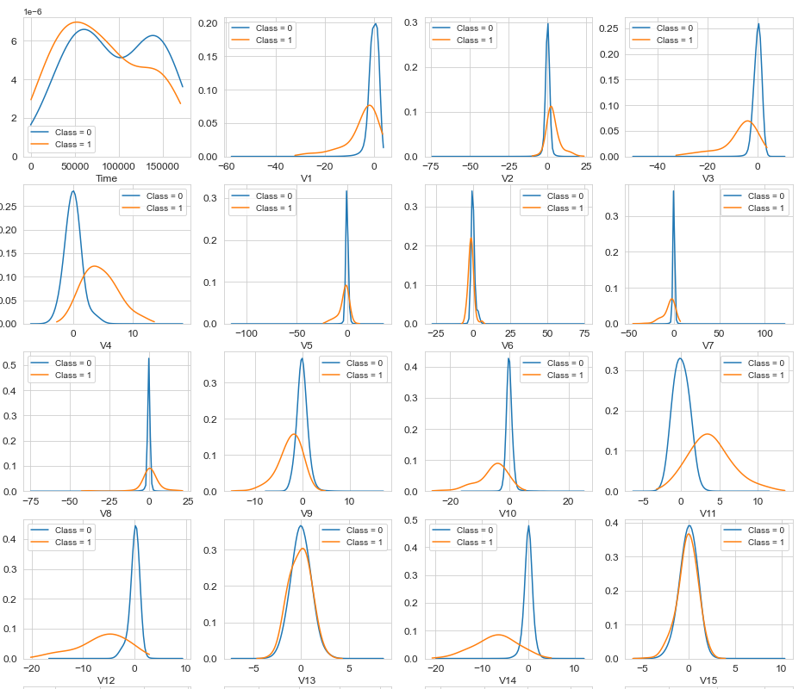
Technique3: Feature Density Plotting
In general, with just few exceptions (Time and Amount), the features distribution for legitimate transactions (values of Class = 0) is centered around 0. In the same time, the fraudulent transactions (values of Class = 1) have a skewed (asymmetric) distribution.
For some of the features we can observe a good selectivity in terms of distribution for the two values of Class: V4, V11 have clearly separated distributions for Class values 0 and 1, V12, V14, V18 are partially separated, V1, V2, V3, V10 have a quite distinct profile, whilst V25, V26, V28 have similar profiles for the two values of Class.
Notes:
Autoencoders
An autoencoder is a type of artificial neural network used to learn efficient data codings in an unsupervised manner.
The aim of an autoencoder is to learn a representation (encoding) for a set of data, typically for the purpose of dimensionality reduction.
An autoencoder learns to compress data from the input layer into a short code, and then uncompress that code into something that closely matches the original data. This forces the autoencoder to engage in dimensionality reduction, for example by learning how to ignore noise. Some architectures use stacked sparse autoencoder layers for image recognition. The first autoencoder might learn to encode easy features like corners, the second to analyze the first layer's output and then encode less local features like the tip of a nose, the third might encode a whole nose, etc., until the final autoencoder encodes the whole image into a code that matches (for example) the concept of "cat".An alternative use is as a generative model: for example, if a system is manually fed the codes it has learned for "cat" and "flying", it may attempt to generate an image of a flying cat, even if it has never seen a flying cat before.
The simplest form of an autoencoder is a feedforward, non-recurrent neural network very similar to the many single layer perceptrons which makes a multilayer perceptron (MLP) – having an input layer, an output layer and one or more hidden layers connecting them – but with the output layer having the same number of nodes as the input layer, and with the purpose of reconstructing its own inputs (instead of predicting the target value Y given inputs X). Therefore, autoencoders are unsupervised learning models.

Slide 22
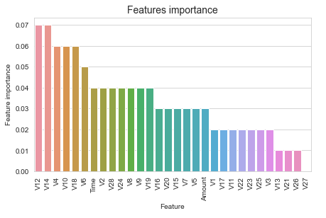
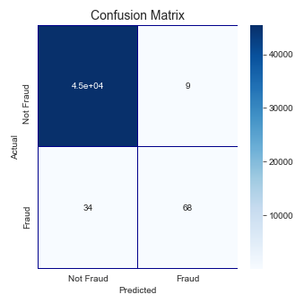
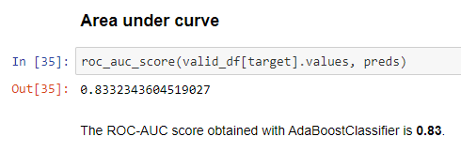
Technique4: Multi-layered ML Models
RandomForest Classifier
AdaBoost Classifier
CatBoost Classifier
Notes:
We investigated the data, checking for data unbalancing, visualizing the features and understanding the relationship between different features. We then investigated two predictive models. The data was split in 3 parts, a train set, a validation set and a test set. For the first three models, we only used the train and test set.
We started with RandomForrestClassifier, for which we obtained an AUC scode of 0.85 when predicting the target for the test set.
We followed with an AdaBoostClassifier model, with lower AUC score (0.83) for prediction of the test set target values.
We then followed with an CatBoostClassifier, with the AUC score after training 500 iterations 0.86.
We then experimented with a XGBoost model. In this case, se used the validation set for validation of the training model. The best validation score obtained was 0.984. Then we used the model with the best training step, to predict target value from the test data; the AUC score obtained was 0.974.
We then presented the data to a LightGBM model. We used both train-validation split and cross-validation to evaluate the model effectiveness to predict 'Class' value, i.e. detecting if a transaction was fraudulent. With the first method we obtained values of AUC for the validation set around 0.974. For the test set, the score obtained was 0.946. With the cross-validation, we obtained an AUC score for the test prediction of 0.93.

Slide 23

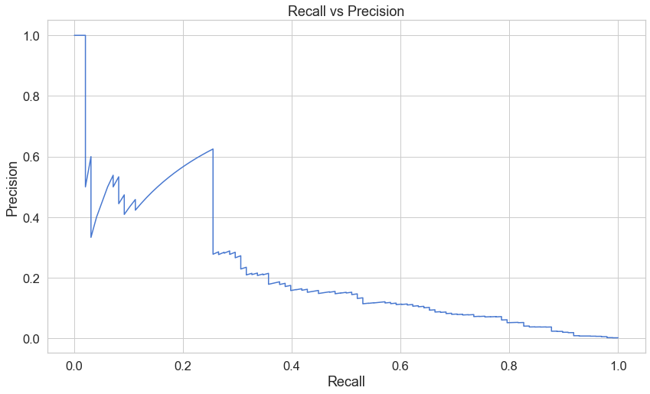
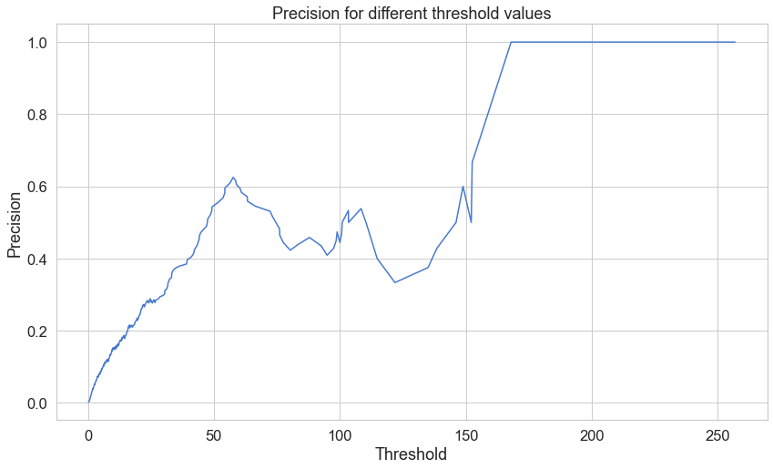
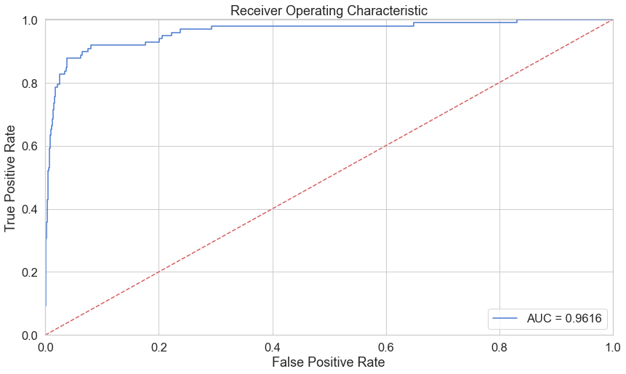
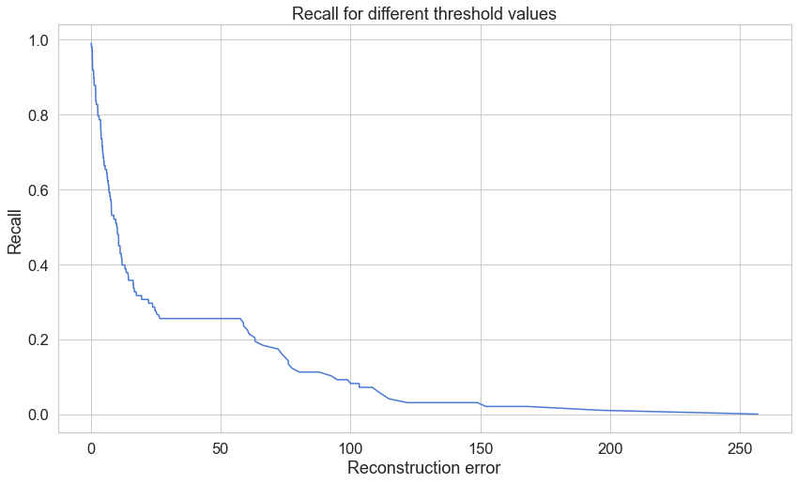
Technique5: Evaluation Metrics and Thresholds
Evaluation Metrics
Threshold Values
Notes:
Our objective was to find a prediction model that could be used as a real-world
fraud detection system. Due to the high class imbalance we decided to focus our
assessment of a particular algorithm on analyzing recall and precision statistics.
For different parameters congurations we obtained results with either high recall
and low precision or low recall and high precision. The former one has an obvious
advantage of capturing most of the frauds that were present in a dataset. On
the other hand, it is completely useless for a real world applications in which all
the alerts have to be manually analyzed by a human being.
As we included almost all of the fraudulent transaction and only minor sample
of non-fraudulent, we had distribution in which probability of a random account
being a fraudulent one was signicantly higher than in the real-world. Because of
that, we could not rely on precision statistic as it is vulnerable to this problem.
Instead of using precision as a false alarm verication cost estimator we decided
to use false positive rate. It ts our purpose since it does not depend on the total
amount of frauds in the dataset.

Slide 24
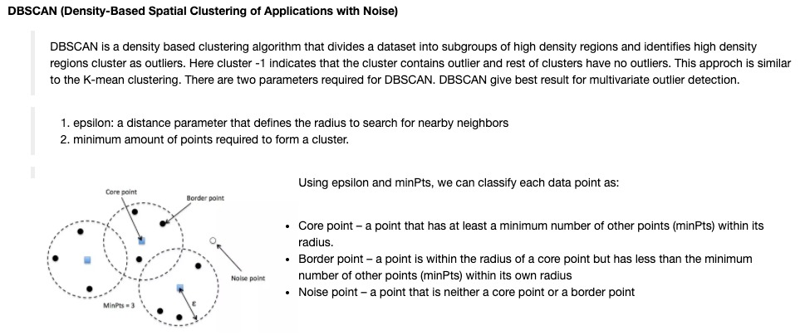
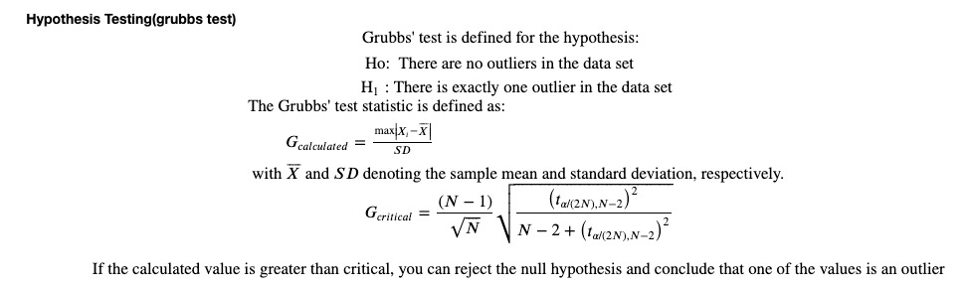
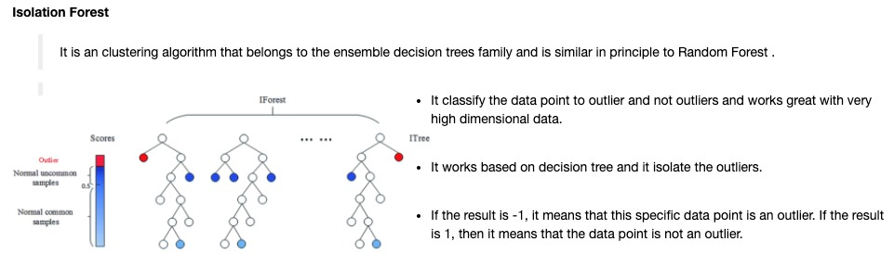
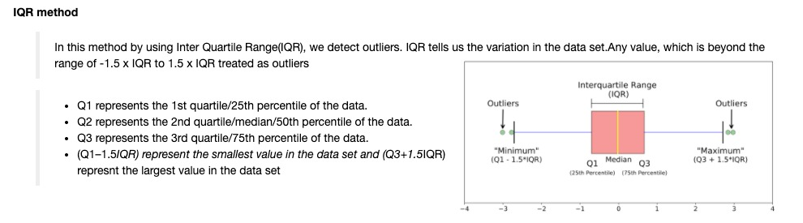
QnA1

Slide 25
QnA2

Slide 26
QnA3

Slide 27
QnA4

